Slide 1
The Era of Big Data: Databases, Information Systems, & Artificial Intelligence
8
Chapter

Slide 2


Chapter Topics
UNIT 8A: Files & Databases
8.1 Managing Files: Basic Concepts
8.2 Database Management Systems
8.3 Database Models
8.4 Data Mining
UNIT 8B: Big Data, Information Systems, & Artificial Intelligence
8.5 The Evolving World of Big Data
8.6 Artificial Intelligence
8.7 Artificial Life, the Turing Test, & the Singularity

Slide 3
8.1 Managing Files
Basic Concepts

Slide 4

Database Management
In all information systems, data resources must be organized and structured in some logical manner so that they can be accessed easily, processed efficiently, retrieved quickly, and managed effectively.
A database is a logically organized collection of related data designed and built for a specific purpose.
Data is stored hierarchically for easier storage and retrieval.
File (table): collection of related records
Records (row): collections of related fields
Field (column): unit of data containing 1 or more characters
Character [Byte]: a letter number or special character made of bits
Bit: 0 or 1
Notes:
Discuss Structure and Unstructured Data
Information systems are interrelated components working together to collect, process, store, and disseminate information to support decision making, coordination, control, analysis, and viualization in an organization

Slide 5
Logical Data Elements
Data may be logically organized into:
character
field
record
file
database

Slide 6
Logical Data Elements
Character
Field (data item)
Record
File (table, flat file)
Database
A single alphabetic, numeric, or other symbol
Consists of a grouping of related characters.
Represents an attribute (characteristic) of some entity (object, person, place, event)
Examples… salary, job title
Grouping of all the fields used to describe the attributes of an entity
Example… payroll records with name, SSN, pay rate
Primary Key.
Group of related records
Integrated collection of logically related data elements
It consolidates records previously stored in separate files into a common pool of data elements that provides data for many applications

Slide 7

A key field (Primary key) is a field (or fields) in a record that holds unique data that identifies that record from all the other records in the table and in the database.
Often an identifying number, such as social security number or a student ID number.
Keys are used to sort records in different ways.
Primary keys must be unique make records distinguishable from one another.
Foreign keys appear in other tables and usually refer to primary keys in particular tables; they are used to relate one table to another (to cross-reference data).
Notes:
EmpID|| EMPNAME|| Phone|| Salary || Department#| Dept Name | Dept Location

Slide 8
8.2 Database Management Systems

Slide 9

Database Management System (DBMS): Set of programs which are used to define, construct and manipulate the database.
Database + DBMS= Database Systems
DBMS benefits:
Reduced data redundancy (redundant data is stored in multiple places, which causes problems keeping all the copies current)
Speed—Modern DBMSs are much faster than manual data-organization systems and faster than older computer-based database arrangements
Improved data integrity—the data is accurate, consistent, and up to date
Timeliness—The speed and efficiency of DBMSs generally ensure that data can be supplied in a timely fashion—when people need it

Slide 10
Ease of sharing—The data in a database belongs to and is shared, usually over a network, by an entire organization. The data is independent of the programs that process the data, and it is easy for nontechnical users to access it.
Ease of data maintenance—DBMS offers validation checks, backup utilities, and standard procedures for data inserting, updating, and deletion
Forecasting capabilities—DBMSs can hold massive amounts of data that can be manipulated, studied, and compared in order to forecast behaviors in markets and other areas that can affect sales and marketing managers’ decisions as well as the decisions of administrators of educational institutions, hospitals, and other organizations
Increased security—Although various departments may share data, access to specific information can be limited to selected users—called Authorization Control.

Slide 11

3 Principal Database Components
Data Dictionary
Repository that stores the data definitions and descriptions of the structure of the data and the database
DBMS Utilities
Programs that allow you to maintain the database by creating, editing, deleting data, records, and files
Also include automated backup and recovery
Report Generator
Program for producing on-screen or printed readable documents from all or part of a database

Slide 12
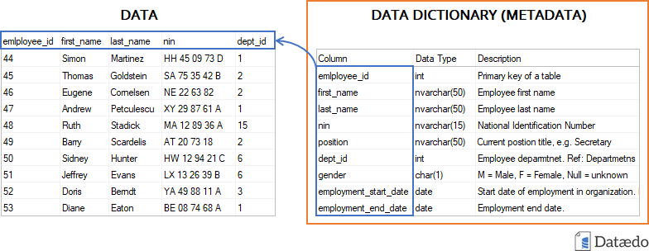
Data Dictionary

Slide 13
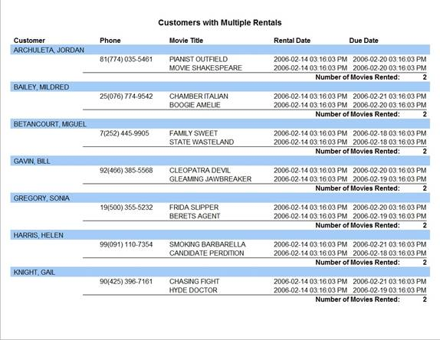
Report Generator

Slide 14
Database Administrator (DBA)
Coordinates all related activities and needs for an organization’s database
Ensures the database’s:
Recoverability
Integrity
Security
Availability
Reliability
Performance

Slide 15
Database Development
Developing a large DB of complex data types can be a complicated task.
DBA and the database Design Analyst work with end users and system analysts to model the business processes and the data they require. Then they determine:
What Data Definitions should be included in the DB.
What Relationships should exist among the data elements.

Slide 16
8.3 Database Models

Slide 17
Database Models
Database management system (DBMS) packages are designed to use a specific data structure to provide end users with quick, easy access to information stored in databases.
Five fundamental database structures:
Hierarchical , Network , Relational, Object-Oriented and Multidimensional Models.

Slide 18
Hierarchical Database
Fields or records are arranged in related groups resembling a family tree with child (low-level) records subordinate to parent (high-level) records
Root record is the parent record at the top of the database, and data is accessed top-down, through the hierarchy
Oldest and simplest; used in mainframes in 1970s
Is rigid in structure and difficult to update
Records arranged in a hierarchy or tree-like structure
Relationships are one-to-many

Slide 19
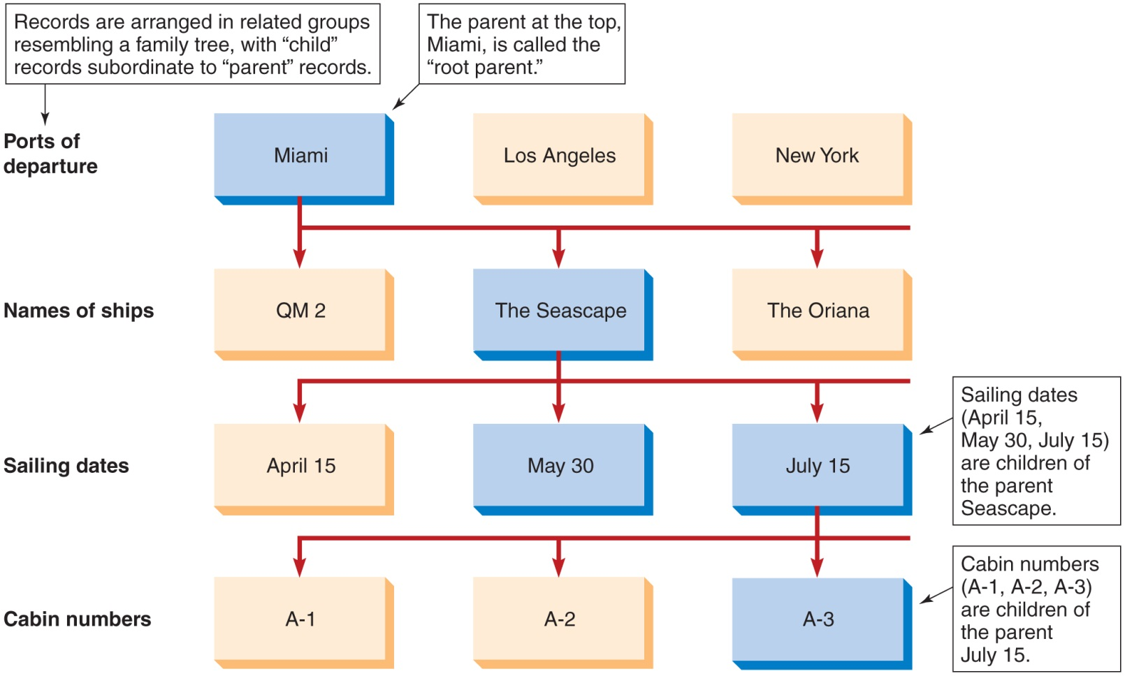
Hierarchical Database

Slide 20
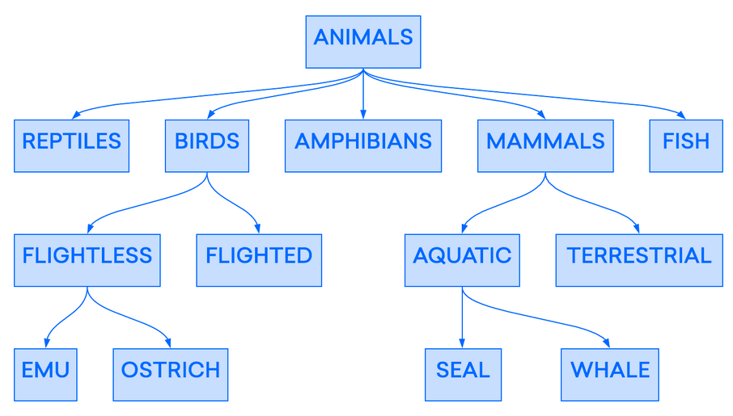
Hierarchical Database

Slide 21
Network Database: created to represent a more complex data relationship effectively, improve database performance, and impose a database standard.
Similar to a hierarchical database but more flexible-- each child record can have more than one parent record
Requires the database structure to be defined in advance; flexibility still lacking.

Slide 22
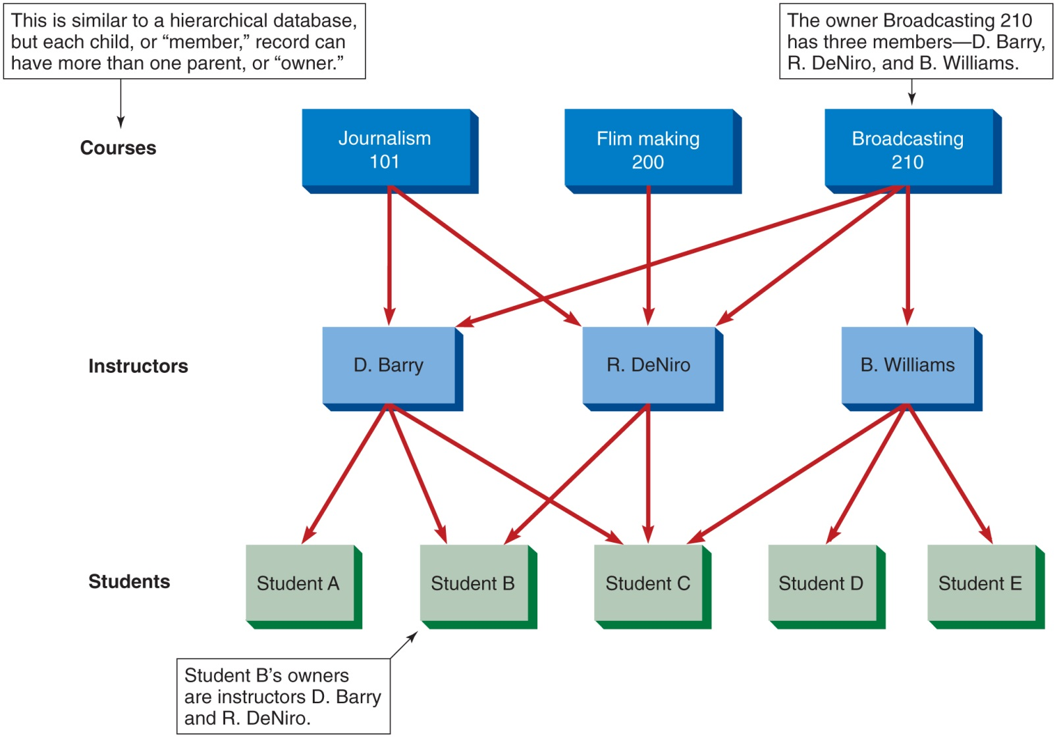
Network Database

Slide 23
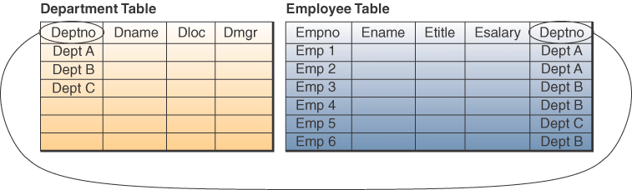
Common Database Structures: Relational
Most widely used structure
Data elements are stored in tables (sometimes referred to as relations).
Row represents a record; column is a field.
DBMS packages based on relational model can relate data in one table with data in another, if both tables share a common data element.

Slide 24
Relational Database: grew out of the hierarchical and network database models
More flexible than previous models; built with SQL
Mainframe relational DB applications:
Oracle10g from Oracle
DB2 from IBM
Midrange DB applications:
SQL Server from Microsoft.
Examples for microcomputers are Paradox and Microsoft Access
Users don’t need to know data structure to use the database

Slide 25
Relational Databases
SQL is a database computer language designed for the retrieval and management of data in a relational database. SQL stands for Structured Query Language. Users employ SQL (structured query language) to create, modify, maintain, and query the database
Applications of SQL:
Allows users to access data in the relational database management systems.
Allows users to describe the data.
Allows users to define the data in a database and manipulate that data.
Allows users to create and drop databases and tables.
Allows users to create view and set permissions on the table

Slide 26
Object-Oriented Database
The object-oriented model is considered one of the key technologies of a new generation of multimedia Web-based applications.
An object consists of
Data values describing the attributes of an entity
Operations that can be performed on the data
Encapsulation →Combine data and operations
Inheritance → New objects can be created by replicating some or all of the characteristics of parent objects
OODBMS now is popular in CAD and in multimedia Web-based applications.
Supports complex data types more efficiently than relational databases
Examples: graphic images, video clips, web pages

Slide 27
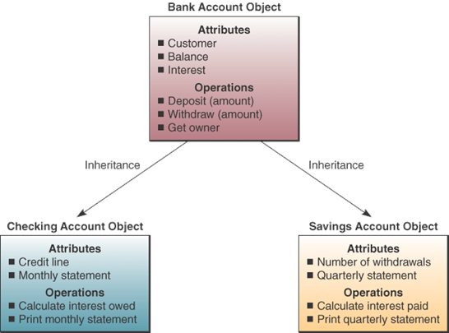
Object-Oriented Database
Major relational DBMS vendors add object-oriented modules to their relational software.
Examples include Multimedia object extensions to IBM’s DB2.

Slide 28
Multidimensional Database
Models data as facts, dimensions, or numerical answers for use in the interactive analysis of large amounts of data for decision-making purposes..
Allows users to ask questions in colloquial language.
Use OLAP* (Online Analytical Processing) software to provide answers to complex database queries.
*OLAP (online analytical processing) is a computing method that enables users to easily and selectively extract and query data in order to analyse it from different points of view.

Slide 29
Multidimensional Database
Variation of relational model that uses multidimensional structures to organize data and express the relationships between them.
Data elements are viewed as being in cubes. Each side of the cube is considered a dimension of the data.
Each dimension represent a different category.

Slide 30
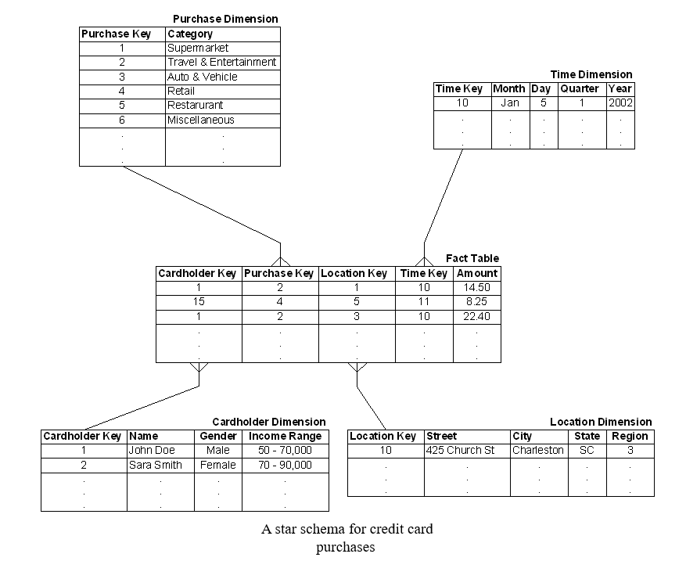

Slide 31
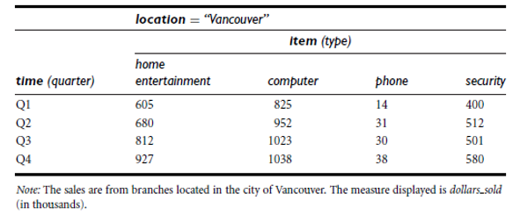
Multidimensional Database
2- Dimensional data Data

Slide 32
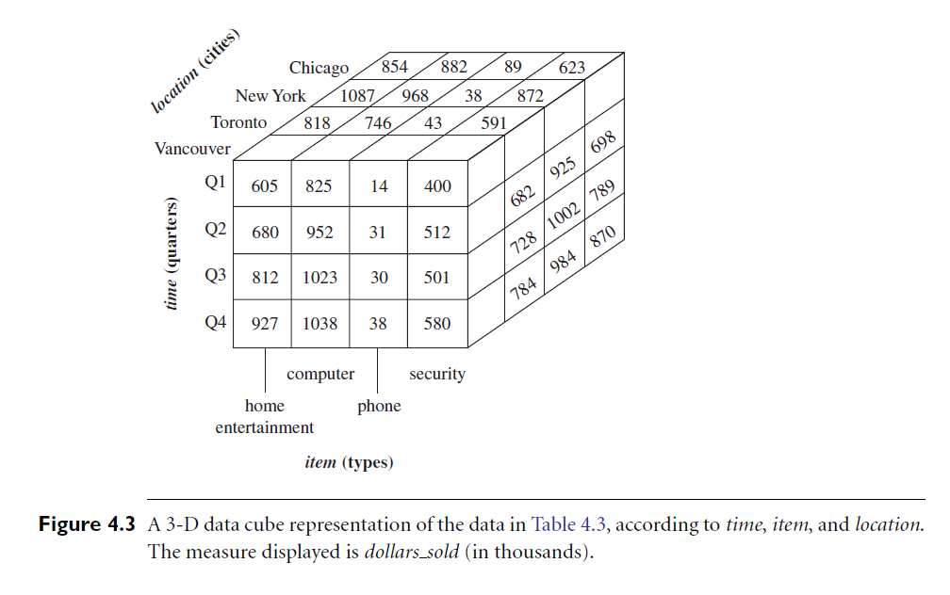
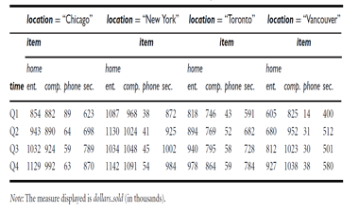
Multidimensional Database
3 - Dimensional data Data

Slide 33
Brief Database Model Overview
Database Type | Description
Hierarchical database | Fields or records are arranged in a family tree, with child records subordinate to parent or higher-level records
Network database | Like a hierarchical database, but each child record can have more than one parent record
Relational database | Relates, or connects, data in different files (tables) through the use of a key, or common data element
Object-oriented database | Uses objects (software written in small, reusable chunks) as elements within database files; multimedia
Multidimensional database | Models data as facts, dimensions, or numerical measures for use in the interactive analysis of large amounts of data

Slide 34
8.4 Data Mining

Slide 35
Data mining is the computer-assisted process of sifting through and analyzing vast amounts of data to extract hidden patterns and meaning and to discover new knowledge.
Transforms Information into Knowledge.
Data is fed into a data warehouse through the following steps:
Identify and connect to data sources
Perform data fusion and data cleansing
Obtain both data and metadata (data about the data)
Transport data and metadata to the data warehouse
Data warehouse is a special database of cleaned-up data and metadata.

Slide 36
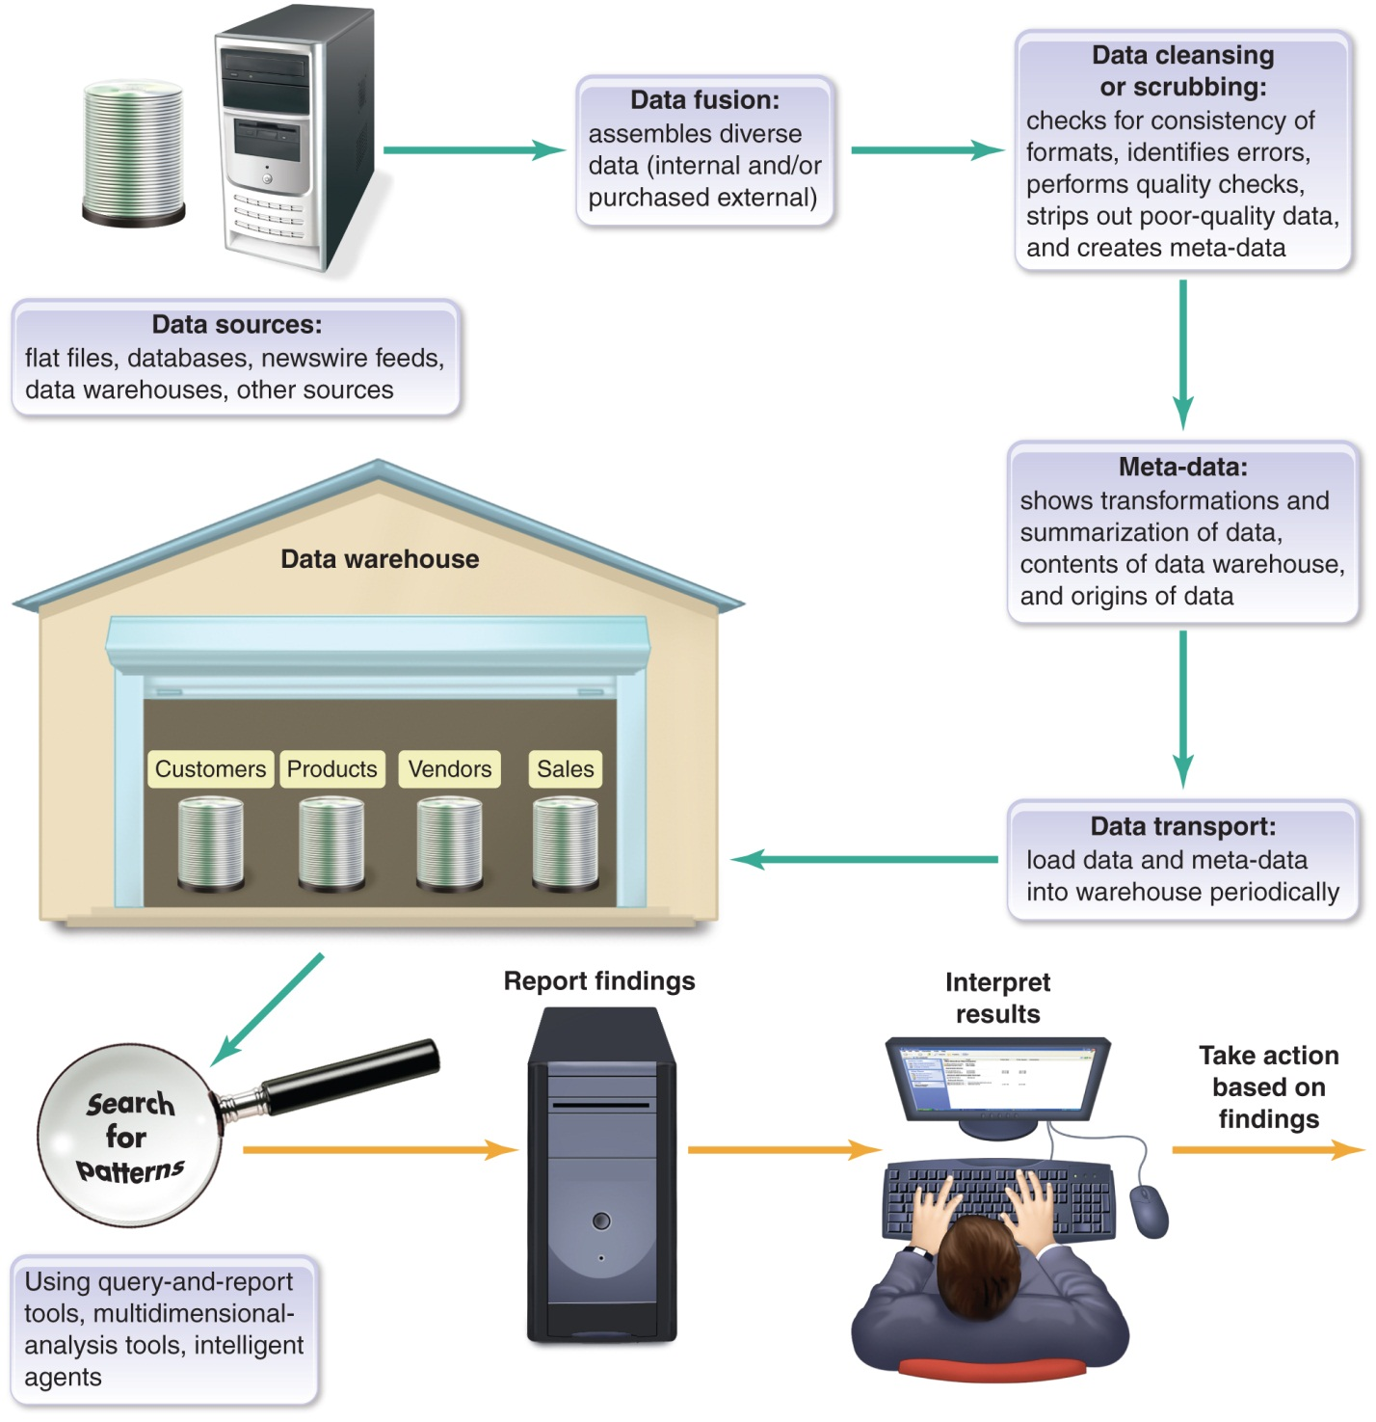
Data Mining

Slide 37
Methods for searching for patterns in the data and interpreting the results
Regression analysis
Develops mathematical formula to fit patterns in the data that has been extracted
Formula is then applied to other data sets of the same type to predict future trends
Classification analysis
Statistical pattern-recognition process that is applied to data sets with more than just numerical data

Slide 38
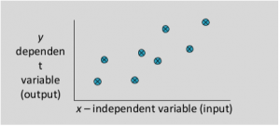
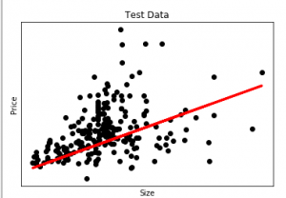
Regression Analysis
1. A regression problem is when the output variable is a real or continuous value.
We have a Housing data set and we want to predict the price of the house.
The red line indicates the best fit line for predicting the price.

Slide 39
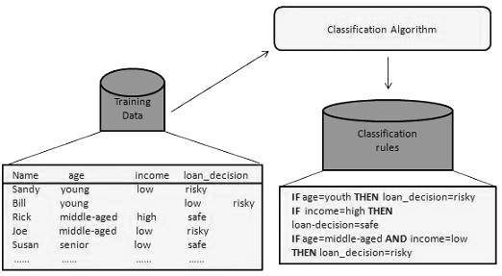
Classification Analysis
A classification problem is when the output variable is a category.
Example: Predicting if the loan should be approved or not

Slide 40
UNIT 8B: Big Data and Artificial Intelligence
Big Data aims to tap all the web data and other data that is outside corporate databases.
Big Data typically means applying the tools of Artificial Intelligence to vast new sources of data beyond that captured in standard databases.
The new data sources include web-browsing data trails, social network communications, sensor data, and surveillance data.

Slide 41
8.5 The Evolving World of Big Data

Slide 42
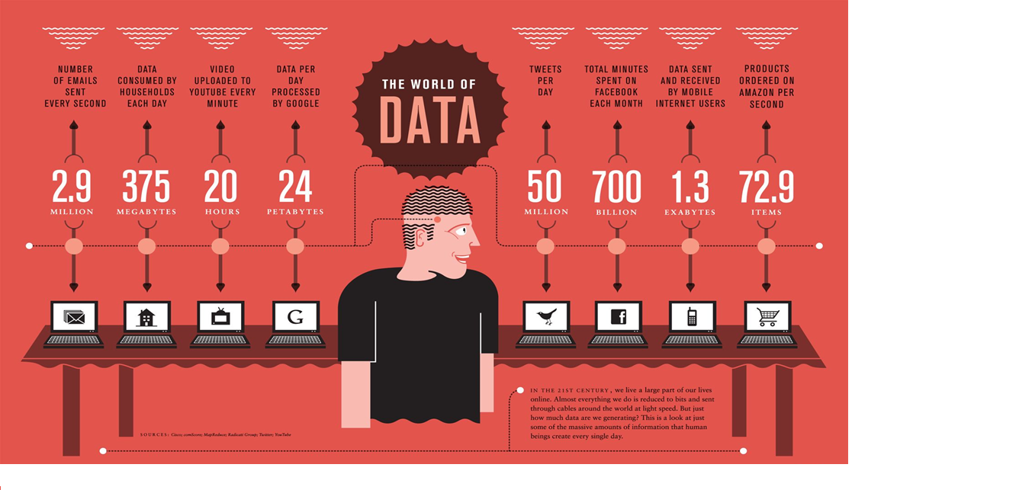

Slide 43
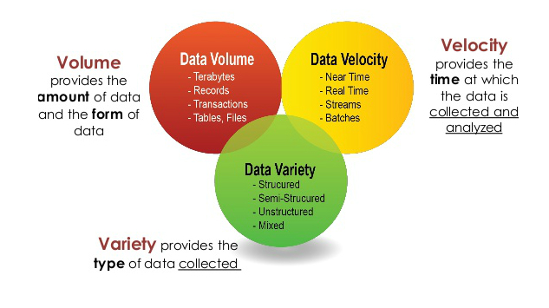

Slide 44
BIG DATA COMPANIES TO KNOW
IBM
Salesforce
Alteryx
Cloudera
Crunchbase
Google
Oracle
VMware
Unacast
Databricks

Slide 45
Three Implications of Big Data:
Big Data derives from a bundle of old & new data sources, both old and new—
To make sense of the oceans of data, there is advanced
computer processing and storage plus complex software taken
from the evolving world of artificial intelligence.
The software applies Big Data Analytics -- the process of examining large amounts of data of a variety of types to uncover hidden patterns, unknown correlations, and other useful information.
A specific kind of analytics is Web analytics, the measurement and analysis of Internet data to understand web usage.

Slide 46

2. Big data could lead to a revolution in measurement: The volume and variety of data, along with the powerful smart software, could revolutionize how things are measured.
—just as the invention of the telescope opened up the heavens and the microscope unveiled the mysteries of biological life down to the cellular level.
In business management, for example, new kinds of measurement could replace old ideas, organizations, and ways of thinking about the world.

Slide 47
3. Big data could lead to better decision making: Not only can data-driven insights be used to make sense of incredibly complex situations.
Big Data “can help compensate for our overconfidence in our own intuitions and can help reduce the extent to which our desires distort our perceptions.”
In short, Big Data is a term for a process that has the potential to transform everything.

Slide 48
Uses of Big Data:
Big Data is finding major uses in:
Medical research,
Marketing,
Politics,
Entertainment Programming

Slide 49
8.7 Artificial Intelligence

Slide 50

Artificial intelligence is the branch of computer science concerned with making computers behave like humans.
Attempts to mimic human intelligence through logic and symbol manipulation, as well as statistics.
This branch of AI is based on machine learning, which is the development of techniques that allow a computer to simulate learning by generating rules from raw data fed into it.
Expert systems, for example, make heavy use of this kind of AI.

Slide 51

AI Areas include:
Expert systems
Natural language processing
Pattern recognition
Robotics
Fuzzy logic
And many more

Slide 52
Expert Systems
Built by knowledge engineers
Include surface knowledge and deep knowledge
Three components of an expert system:
Knowledge base: an expert system’s database of knowledge about a particular subject
Inference engine: the software that controls the search of the expert system’s knowledge base and produces conclusions
User interface: the display screen for the user to interact with the expert system

Slide 53
Expert Systems: Examples
Examples: There are many examples of expert system. Some of them are given below:
MYCIN: One of the earliest expert systems based on backward chaining. It can identify various bacteria that can cause severe infections and can also recommend drugs based on the person’s weight.
DENDRAL: It was an artificial intelligence based expert system used for chemical analysis. It used a substance’s spectrographic data to predict it’s molecular structure.
PXDES: It could easily determine the type and the degree of lung cancer in a patient based on the data.
CaDet: It is a clinical support system that could identify cancer in its early stages in patients.
DXplain: It was also a clinical support system that could suggest a variety of diseases based on the findings of the doctor.

Slide 54
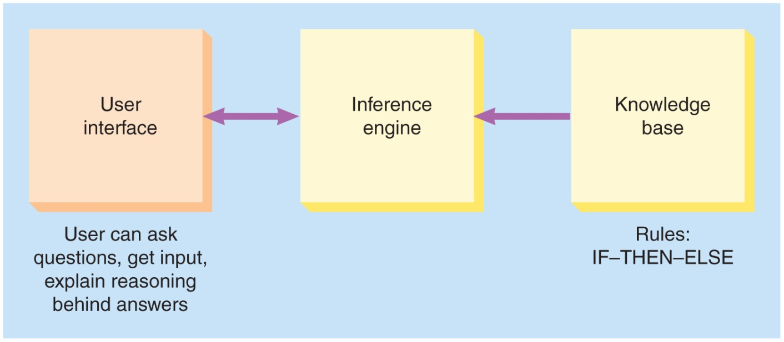
Expert System

Slide 55
Natural language processing
Allows users to interact with a system using normal language
The study of ways for computers to recognize and understand human language
Spell check.
Autocomplete.
Voice text messaging.
Spam filters.
Related keywords on search engines.
Siri, Alexa, or Google Assistant.

Slide 56
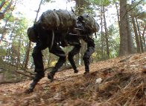
Robotics
The development and study of machines that can perform actions that are normally done by people
Robots grouped by locomotion system: grouped according to their means of locomotion, which defines their shape. Thus, there are stationary, wheeled, legged, swimming, flying, rolling, swarm, modular, micro, nano, soft elastic, snake, and crawler robots (includes drones).
Robots grouped by application: grouped according to the application they are supposed to perform, so that shape is not important. Thus, in health and medicine, there are wearable machines to help amputees walk, wheeled robots (medi-bots) that roam hospital halls and make visits to patients on behalf of their doctors, and robots used in surgery that perform actual operations.

Slide 57
Fuzzy logic
A method of dealing with imprecise data and uncertainty, with problems that have many answers rather than one
The conventional logic block that a computer can understand takes precise input and produces a definite output as TRUE or FALSE, which is equivalent to human’s YES or NO.
Fuzzy Logic (FL) is a method of reasoning that resembles human reasoning. The approach of FL imitates the way of decision making in humans that involves all intermediate possibilities between digital values YES and NO.

Slide 58
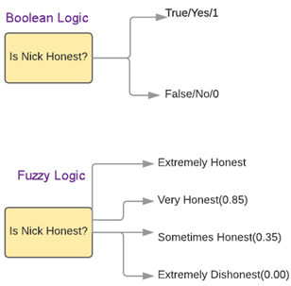

Slide 59
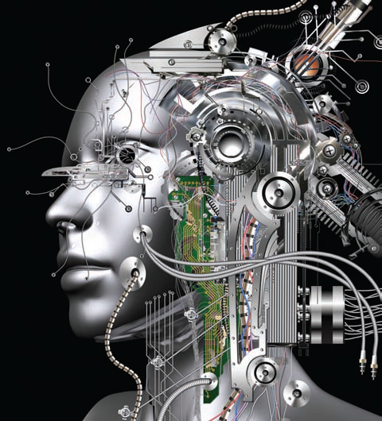

Smarter-Than-Human Computers
The Singularity
A moment when humans would have created self-aware, smarter-than-human machines capable of designing computers and robots that are better than humans can design today
Also may involve transferring the contents of human brains and thought processes into a computing environment

Slide 60

Ethics in A.I.
Ethics underlies everything having to do with AI.
Computer software is subtly shaped by the ethical judgments and assumptions of its creators; there is no human-values-free / bias-free software.
Safety
Responsibility
Privacy
Will AI cause humans to lose control of computer systems?
Notes:
moral principles that govern a person's behaviour or the conducting of an activity.

Slide 61
Databases: Concerns about Privacy & Identity Theft
Databases have facilitated loss of privacy and identity theft, which have become significant concerns for many people.

